Slide 1
INTRODUCTION
The Manufacturing Analytics Project was developed to provide an integrated and data-driven view of production performance by combining insights from multiple analytical tools — Excel, SQL, Power BI, and Tableau. The goal of this project is to assess how efficiently manufacturing operations are performing, identify production bottlenecks, monitor rejection patterns, and evaluate resource utilization across machines and employees.
By using SQL for data extraction and transformation, Excel for initial cleaning and validation, and visualization platforms like Power BI and Tableau for dashboard creation, we established a unified analytical ecosystem. This integration enables management and stakeholders to monitor production health in real time, improve quality control, and make faster, evidence-based business decisions.

Slide 2
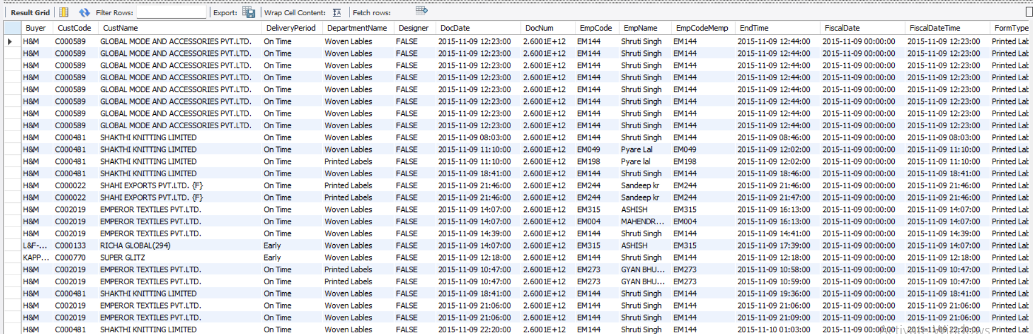
DATA OVERVIEW
The dataset consists of comprehensive production records collected from multiple manufacturing departments. It includes key fields such as Employee Codes, Machine Codes, Departments, Operation Codes, Manufactured Quantity, Processed Quantity, Rejected Quantity, and Wastage Percentage.
The data was extracted using SQL from internal production databases to ensure accuracy and consistency. After extraction, it was refined in Excel, where missing values, duplicates, and data inconsistencies were addressed. The cleaned dataset was then imported into Power BI and Tableau, where relational models were built to connect employees, machines, and departmental performance metrics.
This data spans multiple departments, including Woven Labels, Printed Labels, Cut & Fold, Weaving, and Packing, offering a detailed perspective of the entire manufacturing workflow — from production initiation to final output.

Slide 3
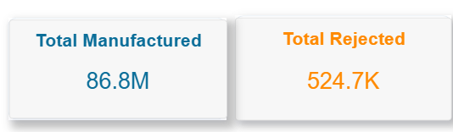
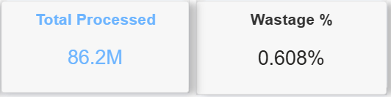
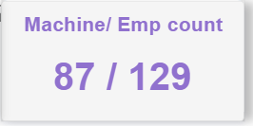
OBJECTIVES
The main objective of this dashboard is to provide management with a real-time snapshot of key performance indicators (KPIs) that reflect the company’s operational efficiency and product quality.
The Manufactured Quantity measures total production output, while the Processed Quantity tracks the amount successfully processed through quality checks. The Rejected Quantity identifies the scale of production losses, helping to pinpoint areas requiring improvement. The Wastage Percentage serves as a critical quality metric, representing material inefficiency or process deviation. Finally, the combined Total Machines and Employees KPI provides insights into workforce and equipment utilization levels.
These KPIs collectively form the foundation for evaluating performance trends, assessing productivity, and monitoring manufacturing consistency across departments.

Slide 4
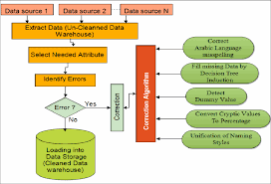
PROCESS
Data Preparation
The process began by using SQL queries to extract relevant production data from the company’s database. Filtering and joins were applied to consolidate employee, machine, and department tables into a single structured dataset.
Next, Excel was used for data cleaning — handling missing entries, removing duplicates, and validating numeric fields such as Manufactured, Processed, and Rejected quantities. Conditional formatting in Excel helped identify anomalies in rejection rates and wastage values before the data was finalized.
This refined data was then imported into Power BI and Tableau, where relationships between different entities were modeled. The analytical tools allowed us to create calculated measures such as Wastage % = (Rejected Qty / Manufactured Qty) × 100, which became one of the core performance indicators.

Slide 5
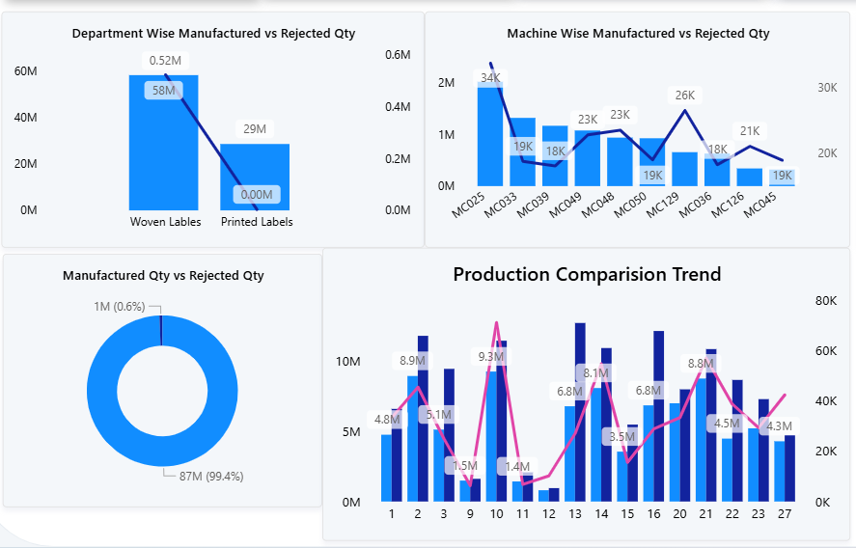
PROCESS Dashboard Development and Visualization
In the visualization stage, both Power BI and Tableau were used to design interactive dashboards.
Power BI was utilized to create KPI cards and visuals that provide a summarized performance overview for management.
Tableau was leveraged for trend analysis and comparison visuals, enabling deeper exploration through filters and drill-downs.
The dashboard features multiple charts, including:
Employee Wise Rejected Quantity – highlighting individual performance and rejection responsibility.
Machine Wise Rejected Quantity – identifying machines contributing most to rejections.
Production Comparison Trend – showing month-over-month or department-wise performance variation.
Manufacture vs Rejected – visualizing the relationship between total production and the rejected portion to understand quality patterns.
This multi-tool approach enhanced both analytical accuracy and visual impact, allowing stakeholders to gain meaningful insights from different perspectives.

Slide 6
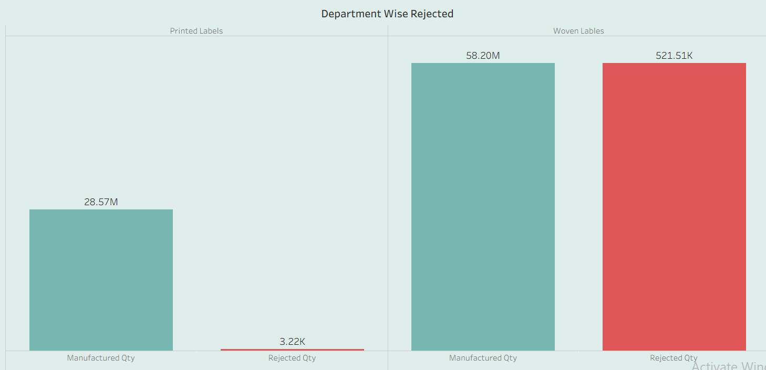
ANALYSIS DEPARTMENT WISE ANALYSIS
The analysis begins at the departmental level, comparing the manufacturing and rejection quantities across different sections. The Woven Labels department exhibited the highest manufacturing volume but also recorded the most rejections, indicating potential quality challenges. In contrast, Printed Labels maintained a smaller production volume but achieved consistent quality with minimal rejections. This variation highlights the departments that drive output versus those that excel in process stability.

Slide 7
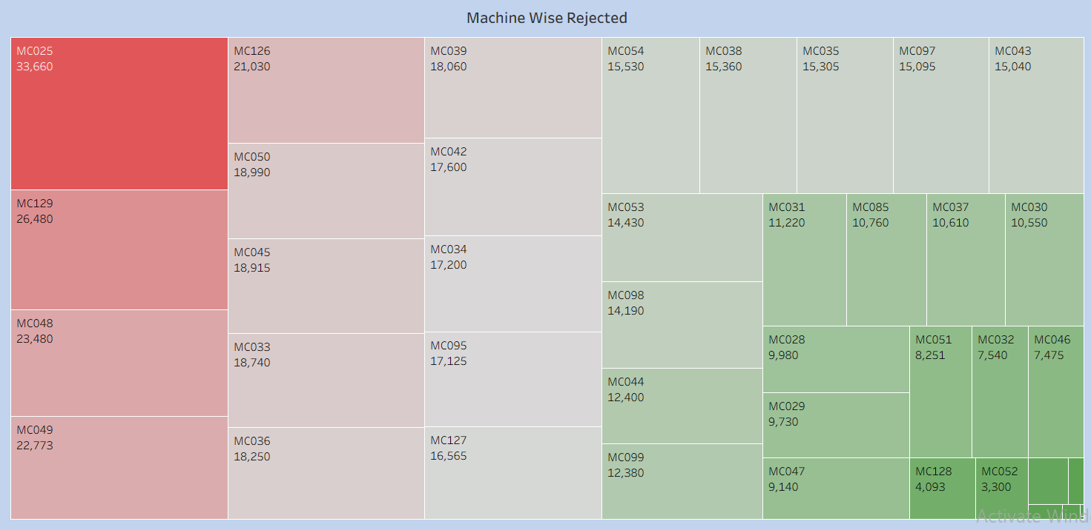
MACHINE-WISE ANALYSIS
The Machine Wise Rejected Quantity chart uncovers which machines are driving higher defect rates. For example, machines like MC025 show high production but also a higher rejection ratio, suggesting potential calibration or maintenance issues. On the other hand, machines like MC048 or MC126 maintain stable output with low rejections, showcasing efficient and reliable performance. This analysis supports maintenance scheduling and machine utilization optimization strategies.

Slide 8
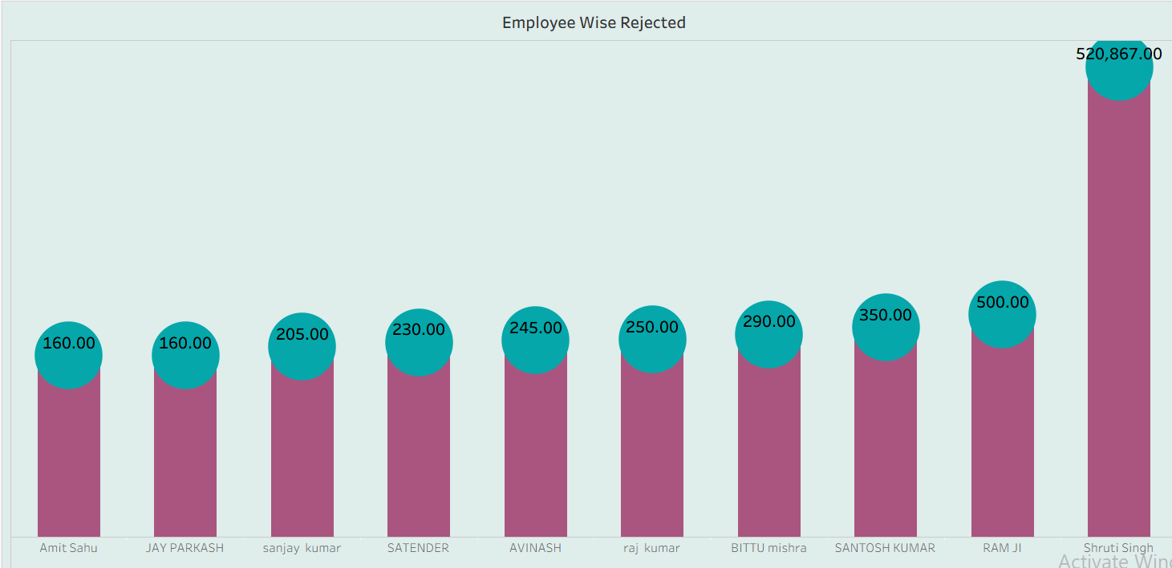
EMPLOYEE-WISE ANALYSIS
The Employee Wise Rejected Quantity chart provides a clear understanding of workforce-related performance issues. Certain employees exhibit consistently low rejection rates, reflecting strong operational precision, while others show higher rejection quantities, indicating a need for process training or supervision. These insights help the HR and production departments identify top performers and areas where targeted skill development is required.

Slide 9
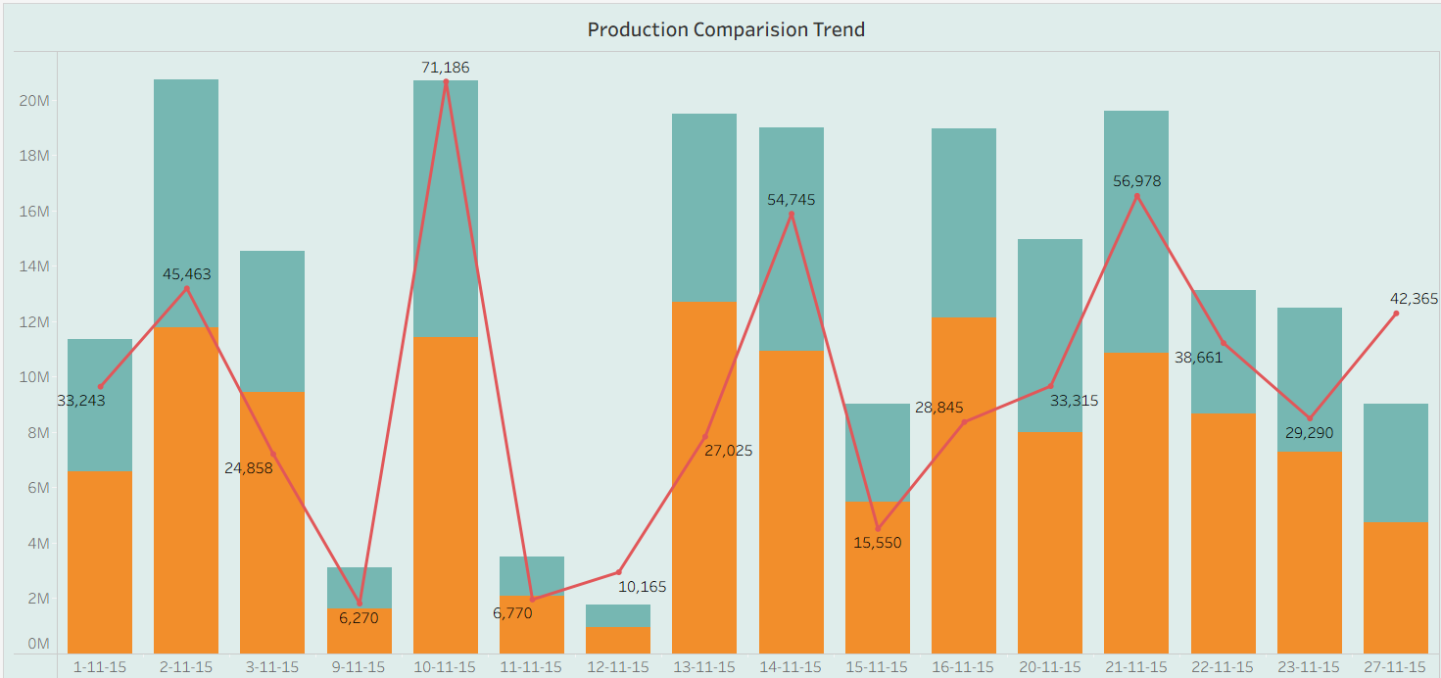
PRODUCTION TREND ANALYSIS
The Production Comparison Trend chart visualizes overall manufacturing progress across different periods or departments. It reveals how production volumes fluctuate and whether output trends are improving or declining. By comparing these patterns with rejection or wastage rates, management can evaluate the impact of operational changes, shifts, or new equipment introductions over time.

Slide 10
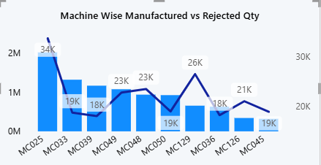
RECOMMENDATIONS & INSIGHTS Operational Recommendations
Based on the analysis, the manufacturing unit should focus on reducing rejections and wastage through enhanced machine calibration and operator training. Machines with consistent rejection patterns should undergo preventive maintenance, and employee performance should be monitored regularly using rejection metrics. Implementing quality inspection at earlier stages of production can further reduce wastage and prevent resource loss.

Slide 11
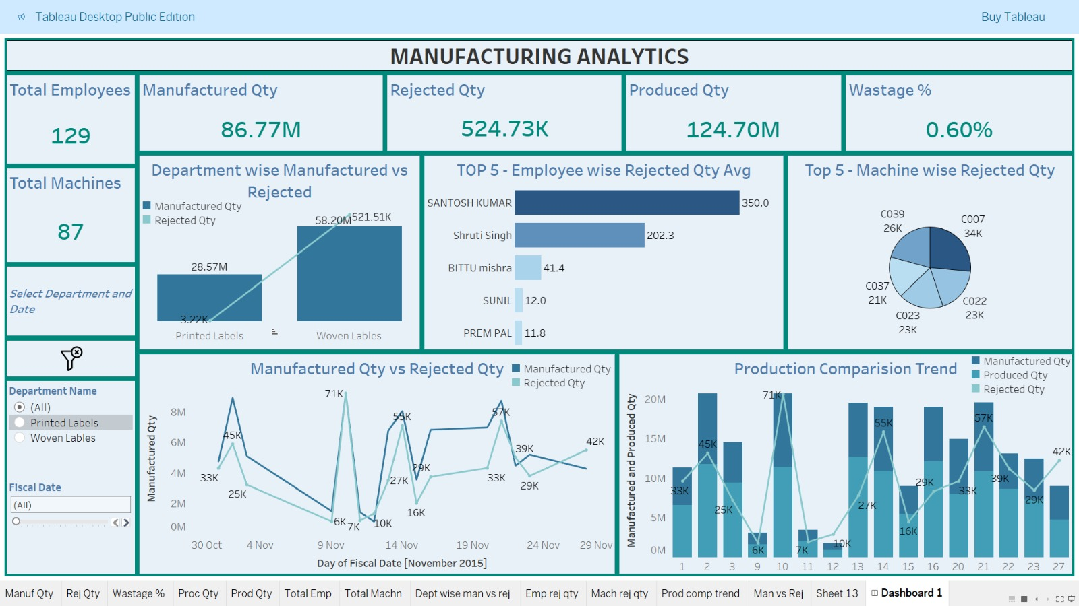
STRATEGIC INSIGHTS
From a strategic viewpoint, integrating SQL-based data pipelines with Power BI and Tableau dashboards ensures continuous monitoring of real-time KPIs. Management can use these insights to reward high-performing employees, reassign underperforming resources, and rebalance machine workloads. The data shows that optimizing the Wastage % metric and maintaining strong Processed Quantity levels are key to sustaining profitability and efficiency across departments.

Slide 12
CONCLUSION
The Manufacturing Analytics Dashboard provides a 360-degree view of production performance by combining SQL, Excel, Power BI, and Tableau capabilities. The organization achieved better transparency over its Manufactured, Processed, and Rejected Quantities, as well as improved understanding of Wastage % and resource utilization.
This unified analytical approach allows stakeholders to identify inefficiencies, predict future production trends, and make data-backed decisions that enhance both productivity and quality. Ultimately, the project demonstrates the power of cross-platform analytics in driving continuous improvement across manufacturing operations.

Slide 13

CHALLENGES & LEARNINGS
During the project, one of the main challenges was data inconsistency between systems, which required thorough cleaning and validation using Excel and SQL. Another challenge was integrating data models across Power BI and Tableau while maintaining measure consistency. Distinguishing between closely related metrics like Manufactured, Processed, and Rejected quantities also required careful logical definition.
From these challenges came valuable learnings — particularly the importance of data governance and the role of multi-tool analytics in enhancing flexibility and accuracy. The project reinforced how collaboration between data engineering (SQL), data cleaning (Excel), and visualization (Power BI & Tableau) can deliver a comprehensive and actionable business intelligence solution.

